Slide 1
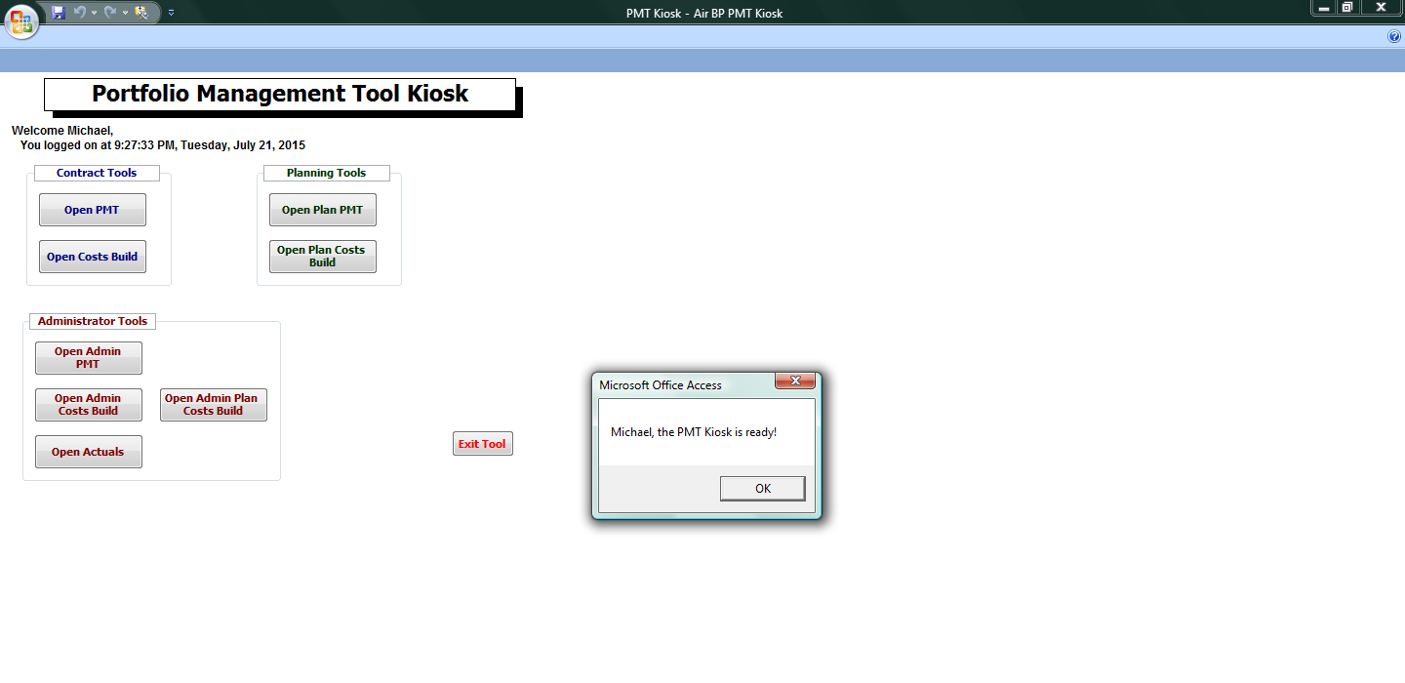
This is the main entry point for the administrator and users to access to tool; based on their Windows Login Authentication (Single Sign On)
This account is for an administrator, with access to the four administrator functionalities

Slide 2
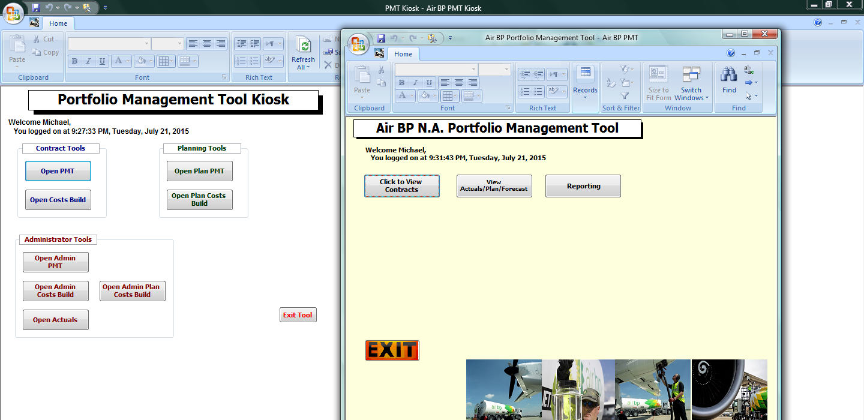
The Portfolio Management Tool (PMT) Kiosk in the background serves as a command center DB. It is used to open other databases such as the administrator tools, contracts, actuals, forecast, planning and supply databases
1.
2.
Clicking the Open PMT button on the left dynamically opens this DB in the foreground
Clicking the View Actuals/Plan/Forecast button opens an interactive form for the user to perform key reporting activities on actuals or plan or forecast of contracts, see next slide

Slide 3
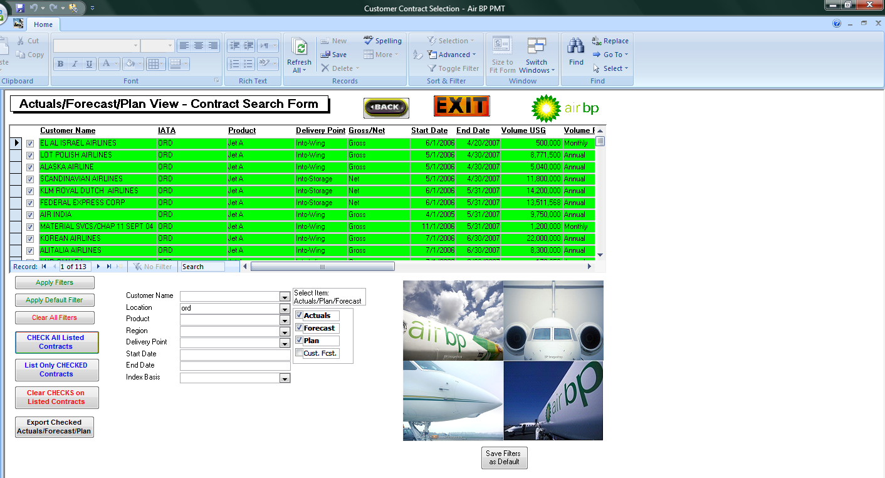
The Contract Search Form is used to retrieve records that match the criteria; in this example searched for contracts at ORD to compare Actuals vs. Forecast vs. Plan
Clicking the Export Checked… button dynamically exports the search results to Excel for further analysis or inclusion in a reporting package or presentation

Slide 4
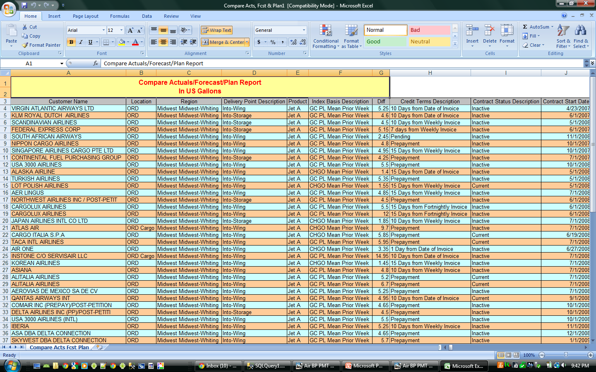
Exported records from Contract Search Form, automatically formatted for improved readability

Slide 5
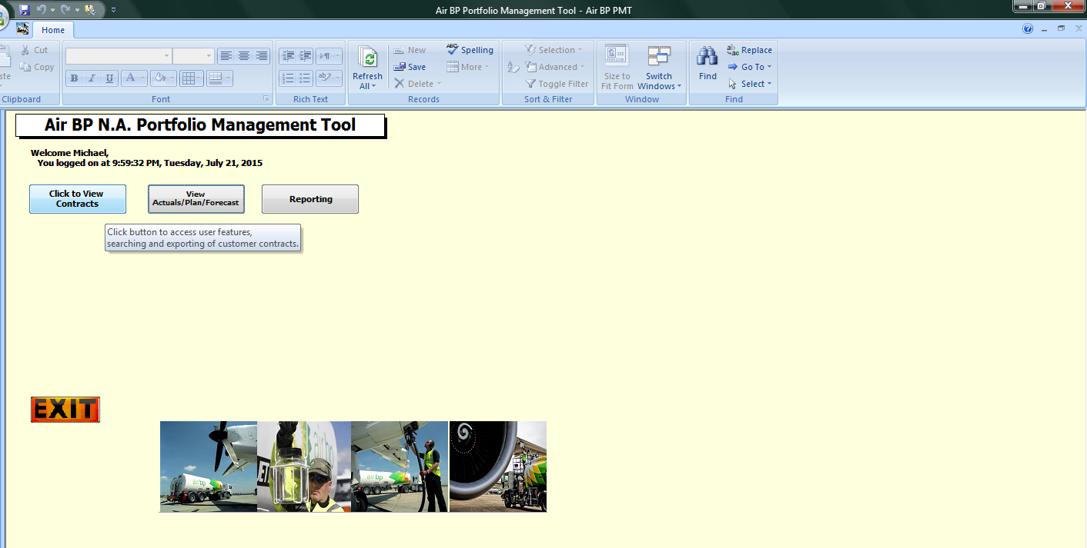
Click to View Contracts button allows non-admin users to access and read contracts
Only in the Administrator Tools database can contracts with created, edited and deleted, this is done to maintain data integrity
The subsequent slide shows retrieved contracts

Slide 6
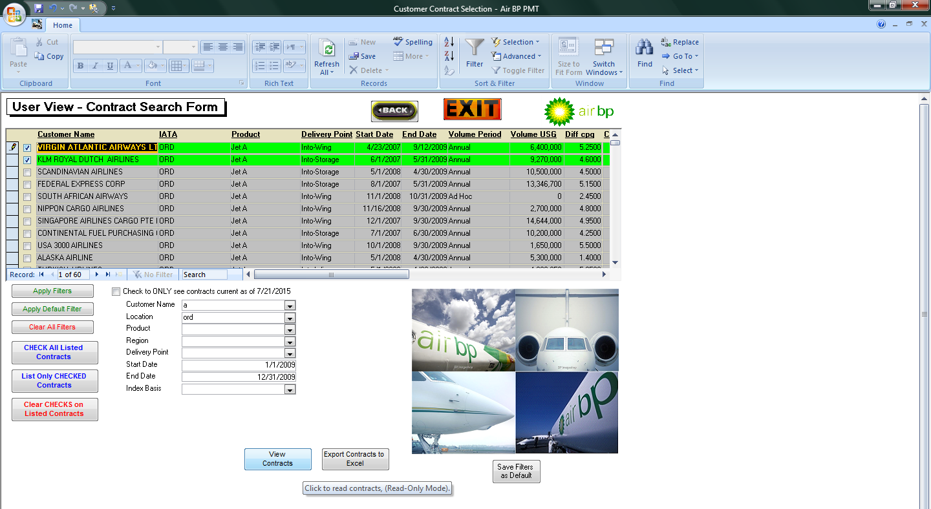
Contract Search Form retrieves records based on the provided search criteria, and the first two records are checked for a detailed review

Slide 7
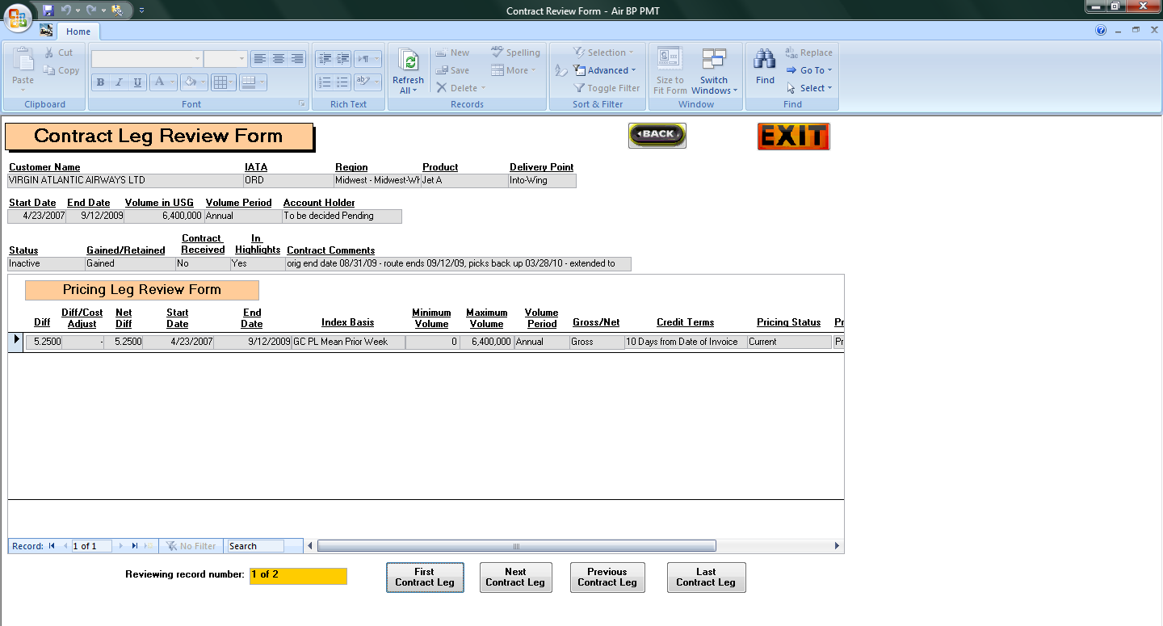
Records cannot edited by user, only the administrator can edit records, the fields are grayed out and cannot be selected

Slide 8
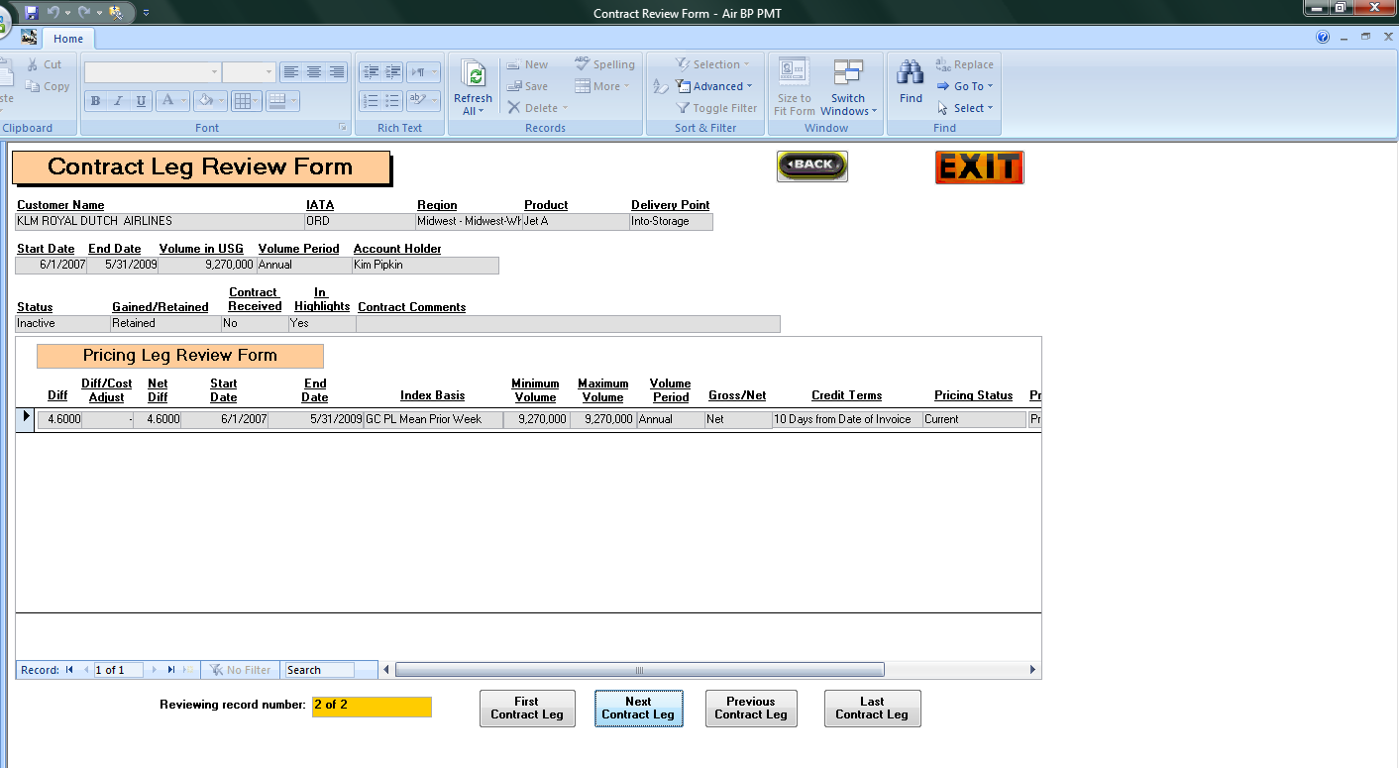

Slide 9
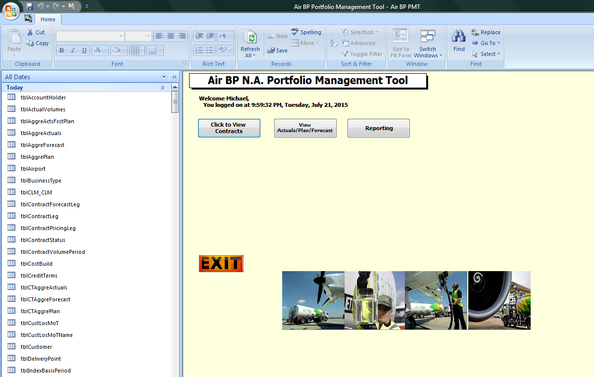
Listing some of the imported tables and queries from SQL Server that are utilized by the current database

Slide 10
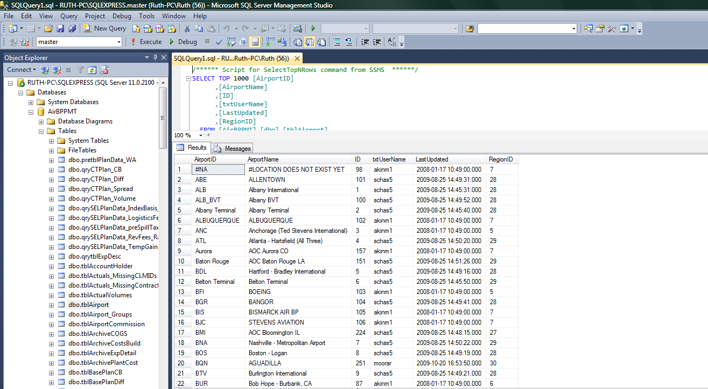
Preview of the SQL Server housing the tables, views (queries), functions and stored procedures

